Slide 1
Lecture 8 – Pressure Loss and Velocity profiles
Friction Loss in a Pipe
Bingham Plastic
= 0

Slide 2
Friction Loss in a Pipe
Bingham Plastic
Buckinghan-Reiner Equation

Slide 3
Friction Loss in a Pipe
Bingham Plastic
Explicit Equation to determine the pressure
drop for a Bingham fluid flowing in a pipe

Slide 4
Friction Loss in a Pipe
Herschel-Bulkley Fluid
=0

Slide 5
Friction Loss in a Pipe
Herschel-Bulkley Fluid

Slide 6
Velocity Profile – Laminar Flow
Q
Velocity Profile u(r)
By integration
Rheological Properties have a strong influence of fluid velocity profile Velocity profiles are important in engineering design, holding tube calculations, etc.

Slide 7
Velocity Profile – Laminar Flow
Newtonian Fluids

Slide 8
Velocity Profile – Laminar Flow
Power law fluids

Slide 9
Velocity Profile in a Fluid with
Yield Stress (Plastic Fluid)
P₁
R
R_{o}
P₂

Slide 10
Bingham Fluid
“Plug”
P₁
R
R_{o}
P₂
By integration

Slide 11
Bingham Plastic Velocity Profile
Bingham
for r > Ro
for r < Ro
Power-Law

Slide 12
For a Herschel-Bulkley Model
For r > R_{o}
For r < R_{o}
Constant Velocity

Slide 13
Equations to Solve Pipeline Design
Calculations
Pumping Power Required
Pump Discharge Pressure
Pressure Drop in the Process
Design of Branched Pipelines
Calculation of Holding Tubes
We have derived equations to
calculate pressure loss in straight
pipes for laminar flow for a variety of fluids
What happens when there are fittings
(bends, valves, T-pieces, etc) in the pipeline?

Slide 14
Friction Losses in Fittings
Empirical Relationships
See Tables 2.5 and 2.6 (pages 135-136) Book (Steffe)
Use Equivalent Length (Le) Concept
Friction Created by Fitting = An Equivalent Length = Le
of Straight Pipe
In general
Empirical
For example for a 90º Elbow
90º Elbow
The fitting has a friction loss
equivalent to 75 diameter of
the existing pipe

Slide 15
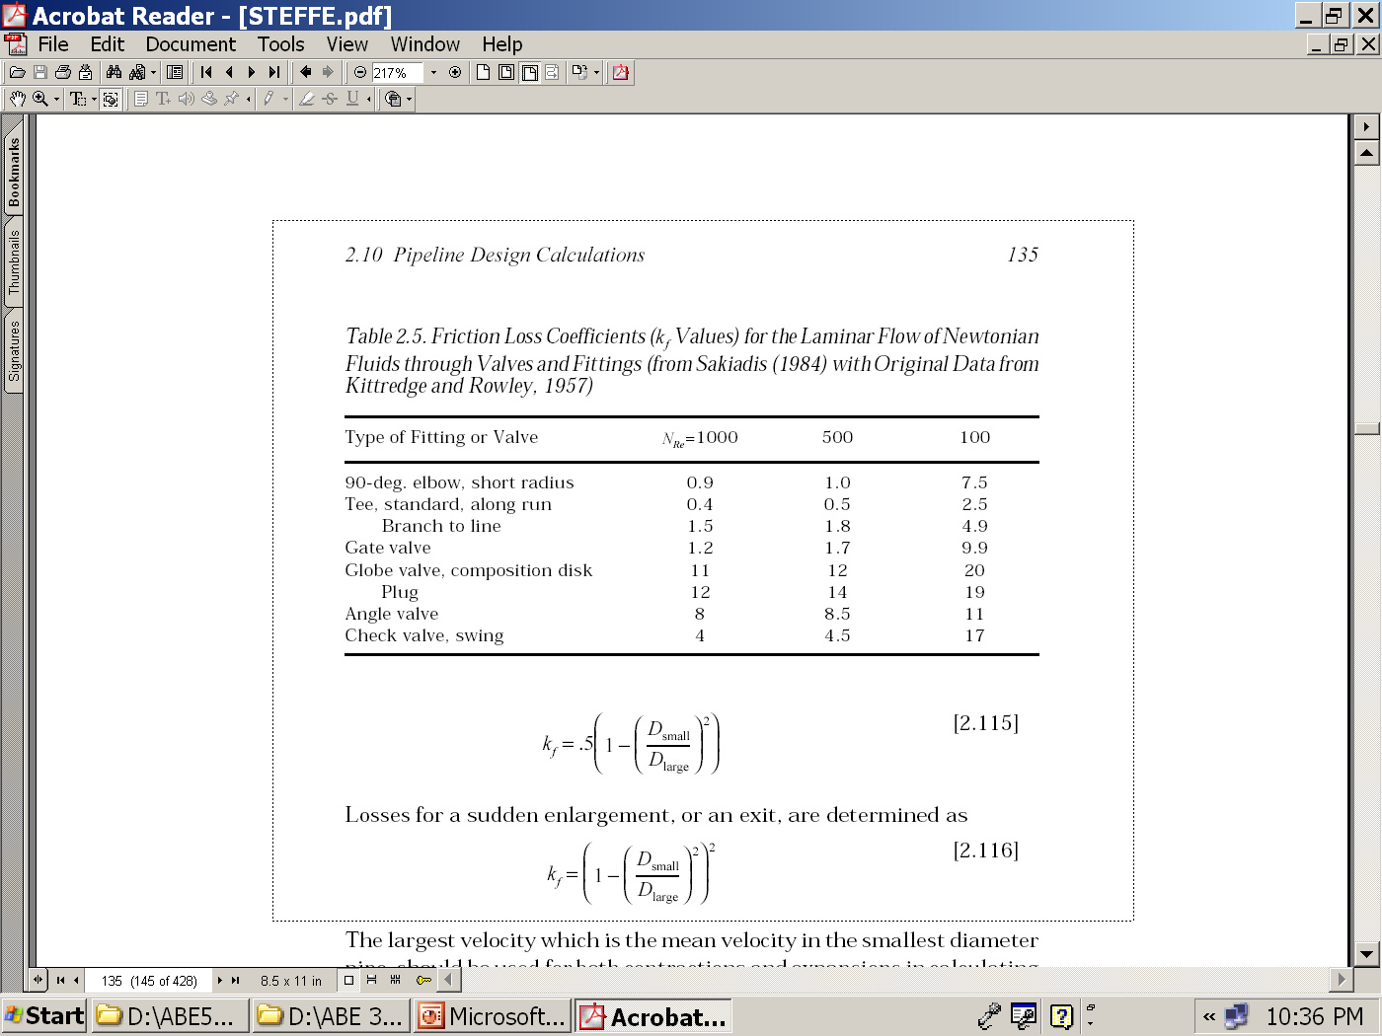
Empirical Tables pages 135-136

Slide 16
Equivalent Length Concept
2
1
Le₁
L₅
Le₁
L₁
Le₁
L₂
Le₂
L₄
L₃
Let’s assume that a power-law liquid is flowing

Slide 17
Kinetic Energy Equation
Velocity Profile
u(r) is the velocity profiles and varies through the pipe
The mean velocity can be measured
A kinetic Energy based on the mean Velocity can be defined
It depends on the Rheology

Slide 18
Fluid
Newtonian
Power-Law
Bingham
Herschel-Bulkley
1

Slide 19
Holding Tube Design
Holding tube design is important in processes
for heat treatment (e.g. pasteurization and
sterilization) liquids in continuous flow. For these
cases the velocity profile rather than the pressure
drop due to friction is important
Q
R
u_{max}
Pasteurization/Sterilization
Heat → Hold → Cool
The problem is usually to determine the correct
length of the holding tube. If the tube is too short
or too long the liquid will be respectively
under-processed or over-processed
Is correct to calculate the length of the holding
tube as ?
Required Holding Time

Slide 20
Holding Time Calculation
Q
u_{max}or
should be used?
The determination of the holding tube length
must be based on the velocity of the fastest-
moving liquid
It was demonstrated that:

Slide 21
Limitations of using direct analytical
solutions of the general equation
Difficulty in classifying a process liquid
as showing one particular type of
rheological behavior rather than another
The rheological behavior of a liquid can
vary with the shear rate. The analytical
approach assumes that the rheological
behavior remains the same over the
entire shear rate range from:
For more complex rheological
constitutive equations (e.g. Herschel-
Bulkley) the pressure drop versus
flow rate relationship is complex

Slide 22
How else could we calculate ?
There are two more approaches
Generalized Scale-up Procedure
Generalized Reynolds number- Friction factor
Still we will use the general equation

Slide 23
1. Generalized Scale-up Procedure
The above equation holds regardless the pipe diameter and length

Slide 24
1. Generalized Scale-up Procedure
How could use this equation?
Factory Situation
L_{f} and D_{f}
Lab Situation
Q
D
L
From lab
measurements

Slide 25
1. Generalized Scale-up Procedure

Slide 26
1. Generalized Scale-up Procedure
From lab
measurements
For a given value of , will have exactly
the same value in any bigger (or smaller) pipeline
regardless the size. Thus for a factory we can
calculate the value and from the chart
determine the value of

